Slide 1
RPART MOODY PREDICTION
By: Tanvi Wagle

Slide 2

Rpart Result without controls

Slide 3
Then I began testing the controls...
These are the different rpart graphs I tested with different controls
Above are only four of my test cases

Slide 4
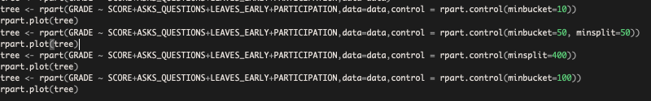
Varied Controlled Rparts
Tried varied combinations of minbucket and minsplit
I tried to increase the minbucket in order to have a more generalized tree. However, as you will see on the next slide the accuracy of the subsets suffered with an increase in minbucket.

Slide 5
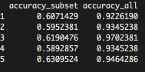
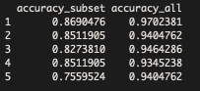
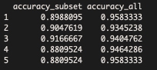
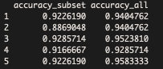
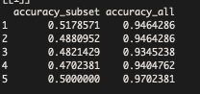
Then I began testing to see if the cross validation for the new RPART graphs was better…
I was checking if the accuracy_subset was consistent and it was higher than accuracy_all
I did not find any of the new rparts to have better subset accuracy. Therefore, I stuck with the original rpart validation
Varied Control RPART CV:
Original Rpart CV:

